Slide 1

Chapter 4
Modeling and Analysis
Turban, Aronson, and Liang Decision Support Systems and Intelligent Systems, Seventh Edition
© 2005 Prentice Hall, Decision Support Systems and Intelligent Systems, 7th Edition, Turban, Aronson, and Liang
4-<number>

Slide 2
Learning Objectives
Understand basic concepts of MSS modeling.
Describe MSS models interaction.
Understand different model classes.
Structure decision making of alternatives.
Learn to use spreadsheets in MSS modeling.
Understand the concepts of optimization, simulation, and heuristics.
Learn to structure linear program modeling.
© 2005 Prentice Hall, Decision Support Systems and Intelligent Systems, 7th Edition, Turban, Aronson, and Liang
4-<number>

Slide 3
Learning Objectives
Understand the capabilities of linear programming.
Examine search methods for MSS models.
Determine the differences between algorithms, blind search, heuristics.
Handle multiple goals.
Understand terms sensitivity, automatic, what-if analysis, goal seeking.
Know key issues of model management.
© 2005 Prentice Hall, Decision Support Systems and Intelligent Systems, 7th Edition, Turban, Aronson, and Liang
4-<number>

Slide 4
Dupont Simulates Rail Transportation System and Avoids Costly Capital Expense Vignette
Promodel simulation created representing entire transport system
Applied what-if analyses
Visual simulation
Identified varying conditions
Identified bottlenecks
Allowed for downsized fleet without downsizing deliveries
© 2005 Prentice Hall, Decision Support Systems and Intelligent Systems, 7th Edition, Turban, Aronson, and Liang
4-<number>

Slide 5
MSS (Mgt Support System) Modeling
Key element in DSS
Many classes of models
Specialized techniques for each model
Allows for rapid examination of alternative solutions
Multiple models often included in a DSS
Trend toward transparency
  Multidimensional modeling exhibits as spreadsheet
© 2005 Prentice Hall, Decision Support Systems and Intelligent Systems, 7th Edition, Turban, Aronson, and Liang
4-<number>

Slide 6
Simulations
Explore problem at hand
Identify alternative solutions
Can be object-oriented
Enhances decision making
View impacts of decision alternatives
© 2005 Prentice Hall, Decision Support Systems and Intelligent Systems, 7th Edition, Turban, Aronson, and Liang
4-<number>

Slide 7
DSS Models
Algorithm-based models
Statistic-based models
Linear programming models
Graphical models
Quantitative models
Qualitative models
Simulation models
© 2005 Prentice Hall, Decision Support Systems and Intelligent Systems, 7th Edition, Turban, Aronson, and Liang
4-<number>

Slide 8
Problem Identification
Environmental scanning and analysis
Business intelligence
Identify variables and relationships
  Influence diagrams
  Cognitive maps
Forecasting
  Fueled by e-commerce
  Increased amounts of information available through technology
© 2005 Prentice Hall, Decision Support Systems and Intelligent Systems, 7th Edition, Turban, Aronson, and Liang
4-<number>

Slide 9
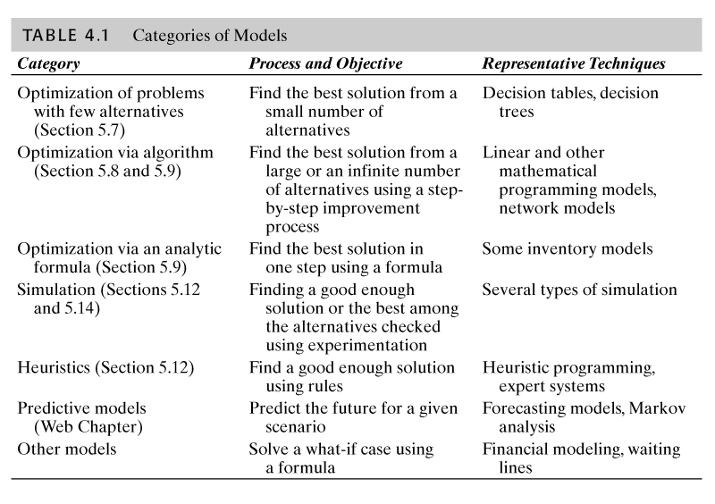
© 2005 Prentice Hall, Decision Support Systems and Intelligent Systems, 7th Edition, Turban, Aronson, and Liang
4-<number>

Slide 10
Static Models
Single photograph of situation
Single interval
Time can be rolled forward, a photo at a time
Usually repeatable
Steady state
  Optimal operating parameters
  Continuous
  Unvarying
  Primary tool for process design
© 2005 Prentice Hall, Decision Support Systems and Intelligent Systems, 7th Edition, Turban, Aronson, and Liang
4-<number>

Slide 11
Dynamic Model
Represent changing situations
Time dependent
Varying conditions
Generate and use trends
Occurrence may not repeat
© 2005 Prentice Hall, Decision Support Systems and Intelligent Systems, 7th Edition, Turban, Aronson, and Liang
4-<number>

Slide 12
Decision-Making
Certainty
  Assume complete knowledge
  All potential outcomes known
  Easy to develop
  Resolution determined easily
  Can be very complex
© 2005 Prentice Hall, Decision Support Systems and Intelligent Systems, 7th Edition, Turban, Aronson, and Liang
4-<number>

Slide 13
Decision-Making
Uncertainty
  Several outcomes for each decision
  Probability of occurrence of each outcome unknown
  Insufficient information
  Assess risk and willingness to take it
  Pessimistic/optimistic approaches
© 2005 Prentice Hall, Decision Support Systems and Intelligent Systems, 7th Edition, Turban, Aronson, and Liang
4-<number>

Slide 14
Decision-Making
Probabilistic Decision-Making
  Decision under risk
  Probability of each of several possible outcomes occurring
  Risk analysis
    Calculate value of each alternative
    Select best expected value
© 2005 Prentice Hall, Decision Support Systems and Intelligent Systems, 7th Edition, Turban, Aronson, and Liang
4-<number>

Slide 15
Influence Diagrams
Graphical representation of model
Provides relationship framework
Examines dependencies of variables
Any level of detail
Shows impact of change
Shows what-if analysis
© 2005 Prentice Hall, Decision Support Systems and Intelligent Systems, 7th Edition, Turban, Aronson, and Liang
4-<number>

Slide 16
Influence Diagrams
Variables:
Intermediate or uncontrollable
Result or outcome (intermediate or final)
Decision
Arrows indicate type of relationship and direction of influence
Certainty
Amount in CDs
Interest earned
Sales
Uncertainty
Price
© 2005 Prentice Hall, Decision Support Systems and Intelligent Systems, 7th Edition, Turban, Aronson, and Liang
4-<number>

Slide 17
Influence Diagrams
~ Demand
Random (risk)
Place tilde above variable’s name
Sales
Sleep all day
Graduate
University
Preference
(double line arrow)
Get job
Ski all day
Arrows can be one-way or bidirectional, based upon the direction of influence
© 2005 Prentice Hall, Decision Support Systems and Intelligent Systems, 7th Edition, Turban, Aronson, and Liang
4-<number>

Slide 18
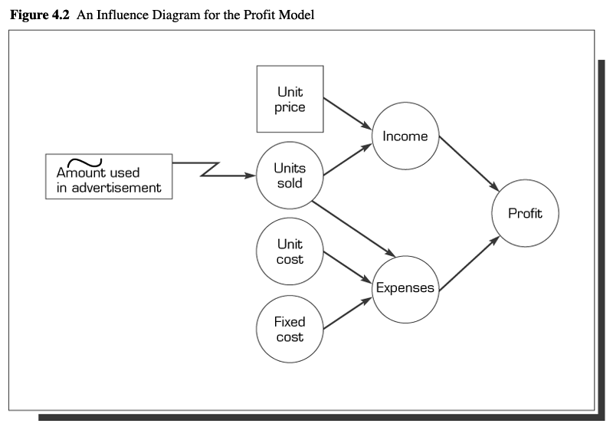
© 2005 Prentice Hall, Decision Support Systems and Intelligent Systems, 7th Edition, Turban, Aronson, and Liang
4-<number>

Slide 19
Modeling with Spreadsheets
Flexible and easy to use
End-user modeling tool
Allows linear programming and regression analysis
Features what-if analysis, data management, macros
Seamless and transparent
Incorporates both static and dynamic models
© 2005 Prentice Hall, Decision Support Systems and Intelligent Systems, 7th Edition, Turban, Aronson, and Liang
4-<number>

Slide 20
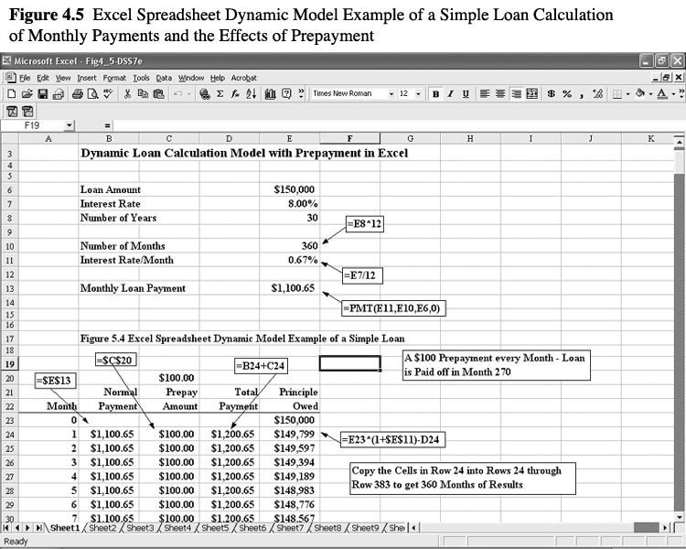
© 2005 Prentice Hall, Decision Support Systems and Intelligent Systems, 7th Edition, Turban, Aronson, and Liang
4-<number>

Slide 21
Decision Tables
Multiple criteria decision analysis
Features include:
  Decision variables (alternatives)
  Uncontrollable variables
  Result variables
Applies principles of certainty, uncertainty, and risk
© 2005 Prentice Hall, Decision Support Systems and Intelligent Systems, 7th Edition, Turban, Aronson, and Liang
4-<number>

Slide 22
Decision Tree
Graphical representation of relationships
Multiple criteria approach
Demonstrates complex relationships
Cumbersome, if many alternatives
© 2005 Prentice Hall, Decision Support Systems and Intelligent Systems, 7th Edition, Turban, Aronson, and Liang
4-<number>

Slide 23
MSS Mathematical Models
Link decision variables, uncontrollable variables, parameters, and result variables together
  Decision variables describe alternative choices.
  Uncontrollable variables are outside decision-maker’s control.
  Fixed factors are parameters.
  Intermediate outcomes produce intermediate result variables.
  Result variables are dependent on chosen solution and uncontrollable variables.
© 2005 Prentice Hall, Decision Support Systems and Intelligent Systems, 7th Edition, Turban, Aronson, and Liang
4-<number>

Slide 24
MSS Mathematical Models
Nonquantitative models
  Symbolic relationship
  Qualitative relationship
  Results based upon
    Decision selected
    Factors beyond control of decision maker
    Relationships amongst variables
© 2005 Prentice Hall, Decision Support Systems and Intelligent Systems, 7th Edition, Turban, Aronson, and Liang
4-<number>

Slide 25
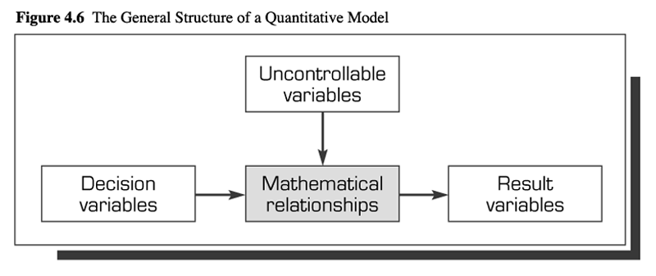
© 2005 Prentice Hall, Decision Support Systems and Intelligent Systems, 7th Edition, Turban, Aronson, and Liang
4-<number>

Slide 26
Mathematical Programming
Tools for solving managerial problems
Decision-maker must allocate resources amongst competing activities
Optimization of specific goals
Linear programming
  Consists of decision variables, objective function and coefficients, uncontrollable variables (constraints), capacities, input and output coefficients
© 2005 Prentice Hall, Decision Support Systems and Intelligent Systems, 7th Edition, Turban, Aronson, and Liang
4-<number>

Slide 27
Multiple Goals
Simultaneous, often conflicting goals sought by management
Determining single measure of effectiveness is difficult
Handling methods:
  Utility theory
  Goal programming
  Linear programming with goals as constraints
  Point system
© 2005 Prentice Hall, Decision Support Systems and Intelligent Systems, 7th Edition, Turban, Aronson, and Liang
4-<number>

Slide 28
Sensitivity, What-if, and Goal Seeking Analysis
Sensitivity
  Assesses impact of change in inputs or parameters on solutions
  Allows for adaptability and flexibility
  Eliminates or reduces variables
  Can be automatic or trial and error
What-if
  Assesses solutions based on changes in variables or assumptions
Goal seeking
  Backwards approach, starts with goal
  Determines values of inputs needed to achieve goal
  Example is break-even point determination
© 2005 Prentice Hall, Decision Support Systems and Intelligent Systems, 7th Edition, Turban, Aronson, and Liang
4-<number>

Slide 29
Search Approaches
Analytical techniques (algorithms) for structured problems
  General, step-by-step search
  Obtains an optimal solution
Blind search
  Complete enumeration
    All alternatives explored
  Incomplete
    Partial search
  Achieves particular goal
  May obtain optimal goal
© 2005 Prentice Hall, Decision Support Systems and Intelligent Systems, 7th Edition, Turban, Aronson, and Liang
4-<number>

Slide 30
Search Approaches
Heurisitic
  Repeated, step-by-step searches
  Rule-based, so used for specific situations
  “Good enough” solution, but, eventually, will obtain optimal goal
  Examples of heuristics
    Tabu search
      Remembers and directs toward higher quality choices
    Genetic algorithms
      Randomly examines pairs of solutions and mutations
© 2005 Prentice Hall, Decision Support Systems and Intelligent Systems, 7th Edition, Turban, Aronson, and Liang
4-<number>

Slide 31
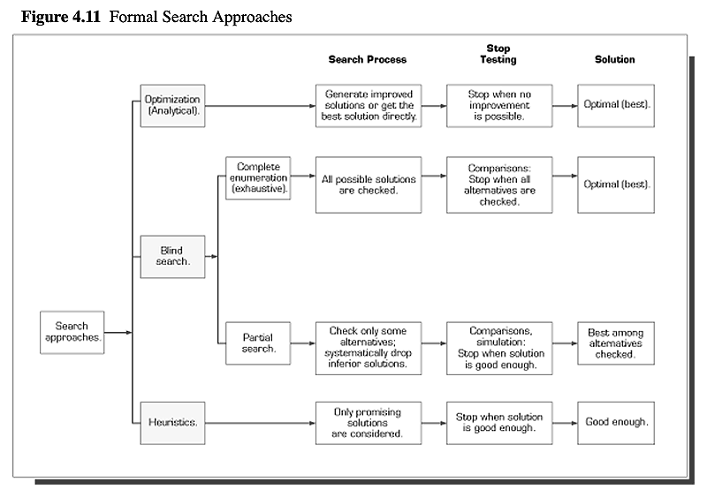
© 2005 Prentice Hall, Decision Support Systems and Intelligent Systems, 7th Edition, Turban, Aronson, and Liang
4-<number>

Slide 32
Simulations
Imitation of reality
Allows for experimentation and time compression
Descriptive, not normative
Can include complexities, but requires special skills
Handles unstructured problems
Optimal solution not guaranteed
Methodology
  Problem definition
  Construction of model
  Testing and validation
  Design of experiment
  Experimentation
  Evaluation
  Implementation
© 2005 Prentice Hall, Decision Support Systems and Intelligent Systems, 7th Edition, Turban, Aronson, and Liang
4-<number>

Slide 33
Simulations
Probabilistic independent variables
  Discrete or continuous distributions
Time-dependent or time-independent
Visual interactive modeling
  Graphical
  Decision-makers interact with simulated model
  may be used with artificial intelligence
Can be objected oriented
© 2005 Prentice Hall, Decision Support Systems and Intelligent Systems, 7th Edition, Turban, Aronson, and Liang
4-<number>

Slide 34
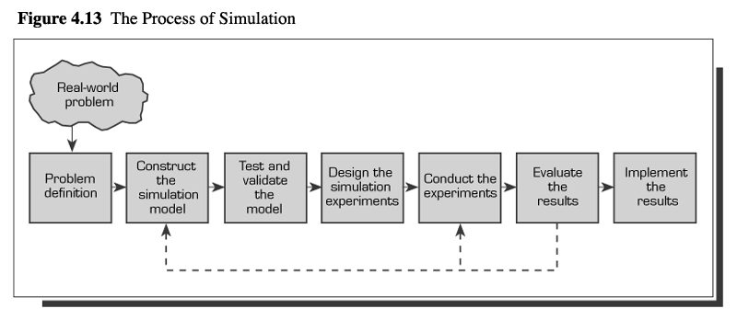
© 2005 Prentice Hall, Decision Support Systems and Intelligent Systems, 7th Edition, Turban, Aronson, and Liang
4-<number>

Slide 35
Model-Based Management System
Software that allows model organization with transparent data processing
Capabilities
  DSS user has control
  Flexible in design
  Gives feedback
  GUI based
  Reduction of redundancy
  Increase in consistency
  Communication between combined models
© 2005 Prentice Hall, Decision Support Systems and Intelligent Systems, 7th Edition, Turban, Aronson, and Liang
4-<number>

Slide 36
Model-Based Management System
Relational model base management system
  Virtual file
  Virtual relationship
Object-oriented model base management system
  Logical independence
Database and MIS design model systems
  Data diagram, ERD diagrams managed by CASE tools
© 2005 Prentice Hall, Decision Support Systems and Intelligent Systems, 7th Edition, Turban, Aronson, and Liang
4-<number>

